Slide 1

G-484
INSULIN DRUG DESIGN
Milestone - 1
M.Nithilesh
M.Nikhil Reddy
M. Harshan
M.Hrushikesh
M.Jatin Rishi

Slide 2

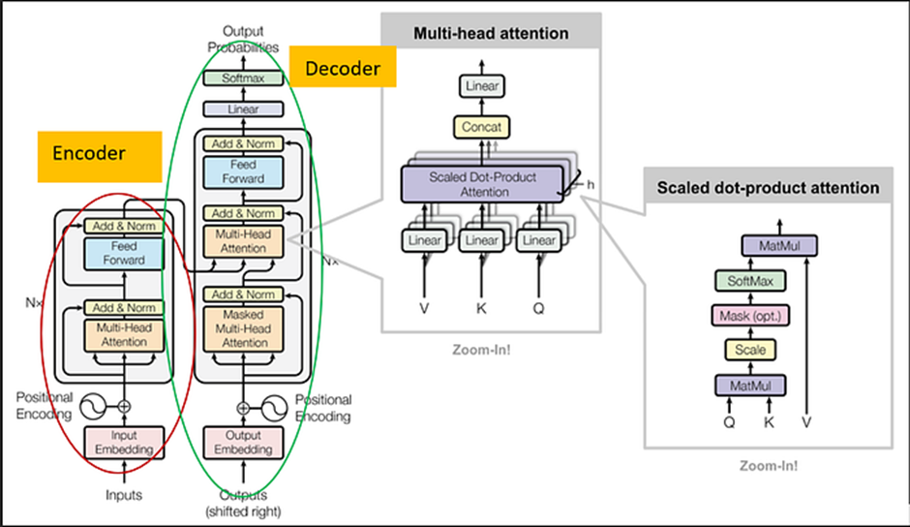
PROGEN-2
Goal: Use large protein language models (PLMs) to design functional, novel proteins.
Applications: Classification, property prediction, protein generation.

Slide 3
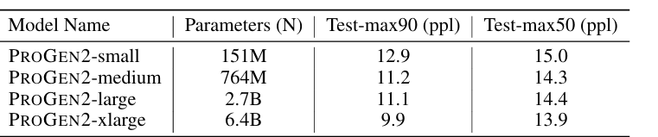
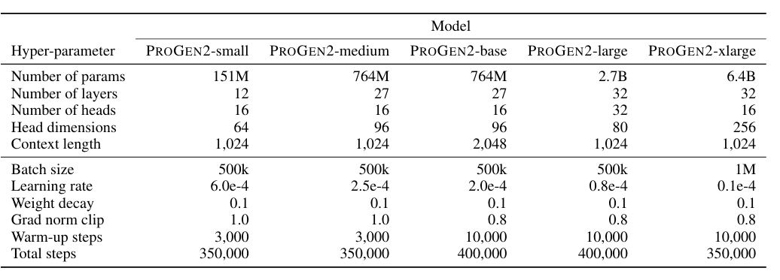
1.2 PROGEN2 MODEL & TRAINING
Architecture: Autoregressive Transformer decoder with parallelized MLP & attention layers for efficiency.
Datasets: UniRef90, BFD30, BFD90, OAS (antibodies).
Preprocessing: Start/End tokens, sequence flipping, packed batches.
Large-scale TPU training with JAXFORMER (data + model parallelism).
Optimizer: Adam + warm-up + cosine decay; stability fixes via LR tuning, weight decay, grad clipping.
Fine-tuning: On specific families (e.g., lysozyme, antibodies) for targeted sequence generation.

Slide 4
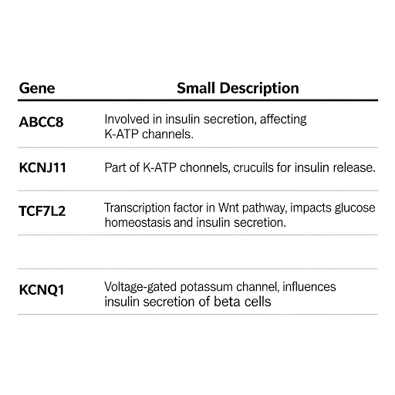
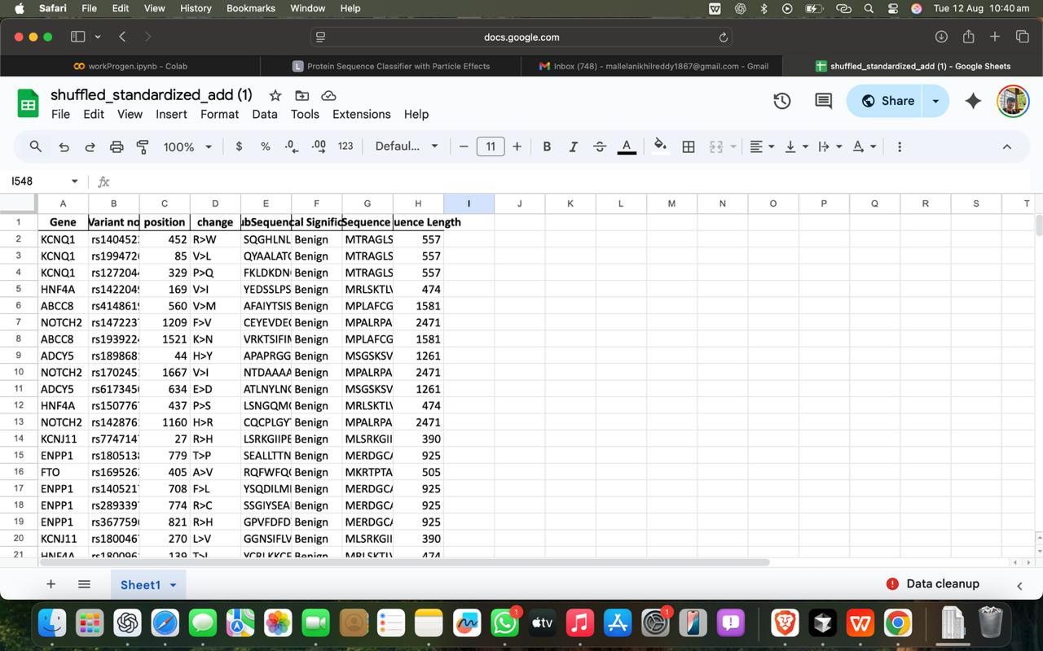
DATASET
Labels split into 4 classes: Pathogenic, Likely Pathogenic, Benign, Likely Benign.
All the data is collected from : UniProt Database

Slide 5
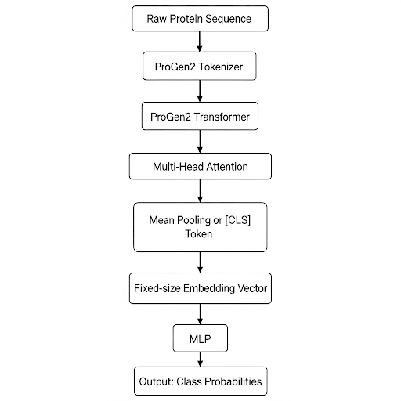
MODEL ARCHITECTURE

Slide 6
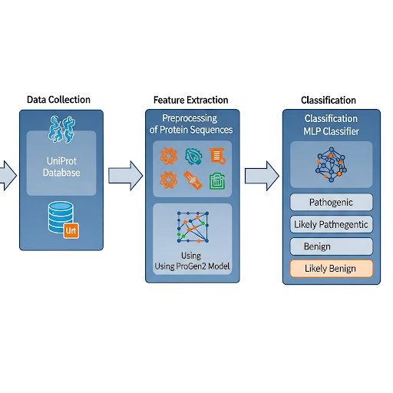
WORKFLOW

Slide 7
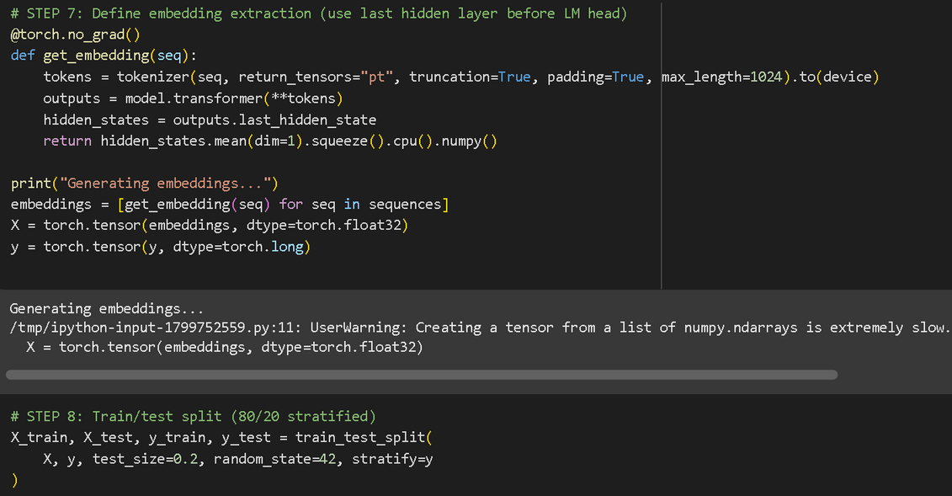
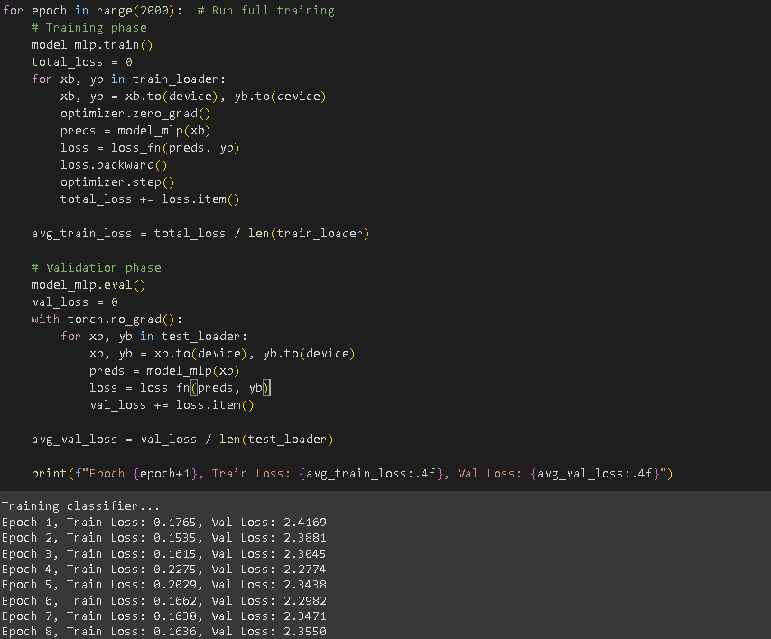
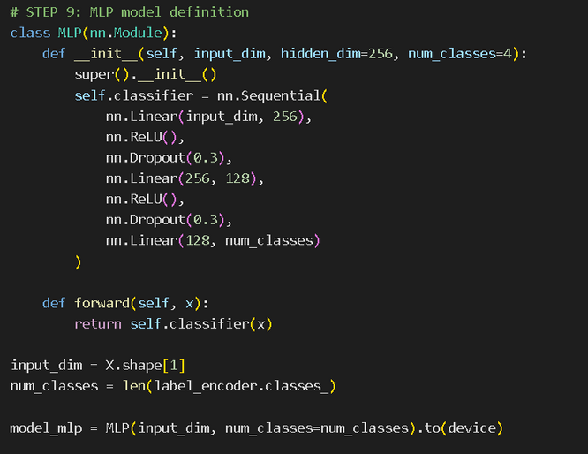
TRAINING

Slide 8
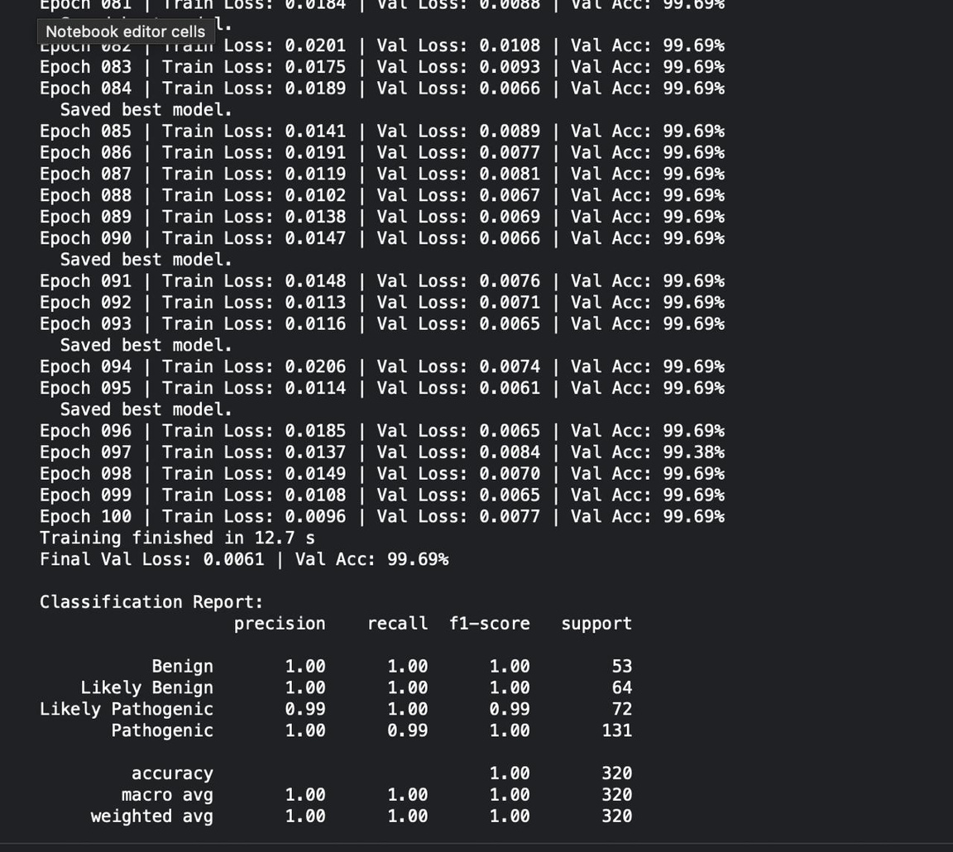
RESULTS

Slide 9
MERN INTEGRATION

Slide 10
THANK YOU

